Slide 1
CBC PERFORMANCE GRADING SYSTEM
Name: Ian Limo Chirchir
Course: Bsc. Software Engineering

Slide 2

Problem Background
Kenya has adopted a new education system to replace the legacy 844 system.
In the CBC system, the following aspects are appreciated
Learner competency through continuous and practical learning.
Non-ranking approach to education
Hence, there is need to develop a system to address the peculiar aspects of this curriculum.

Slide 3
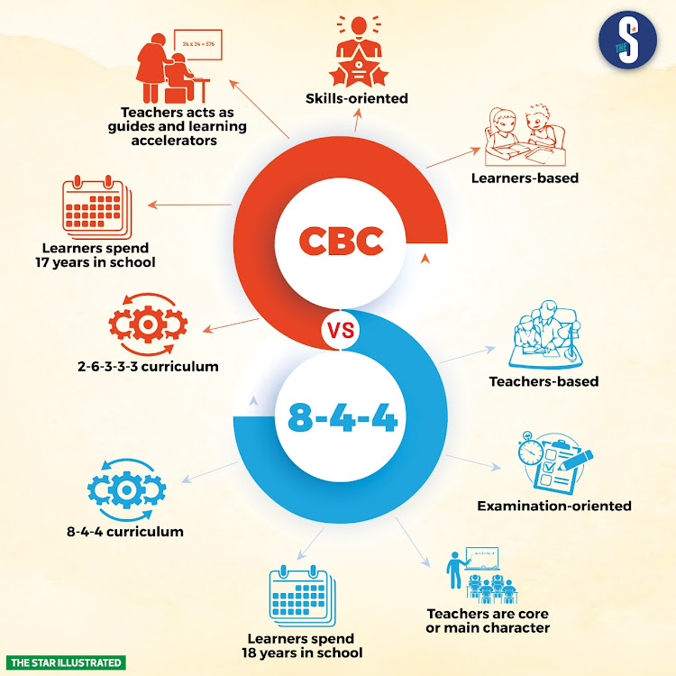
Problem Definition
In Kenya, the somewhat ineffective transition into the CBC curriculum has extrapolated the need for ICT integration.
There are extensive differences between the 844 systema and the CBC curriculum that instigates the need for a new system
Notes:
Education systems are evolving across the world with many factors affected. The need for education reviews towards a holistic and comprehensive process requires adequate technology to support the transition. In Kenya, the ineffective transition into the CBC curriculum has extrapolated the need for ICT integration. In essence, the broad margins between infrastructure tailored towards CBC and those cultured to suit outcome based curricula is evident. Hence, there is need to develop a new system utilizing new technologies to preserve the integrity of behavior and technical education systems.

Slide 4




Research Objectives
Provide real-time performance appraisals as per CBC
Avail an interactive user interface for the grading system
Integrate new academic appraisal fields in the general reward system.
Provide an electronic means of reporting CBC results
Notes:
Provide real-time performance appraisals as per the competency-based system
The system is set to be designed to provide real-time data on the learning performance. This supports the general principles of CBC that requires continuous assessment and inclusion of extra-curricular activities in the learner's assessment.
Avail an interactive user interface for the grading system
The project also has the aim of creating a real-time interactive user interface for keying in performance data for analysis.
Integrate new academic appraisal fields in the general reward system.
The system would introduce new academic appraisal techniques to the academic performance and reward systems that would support the scope of the expansive curriculum.
Provide an electronic means of reporting CBC results
The system also aims at providing reports of the student data captured within the system. This is effective in assessing the performance garnered by different students and institutions.

Slide 5
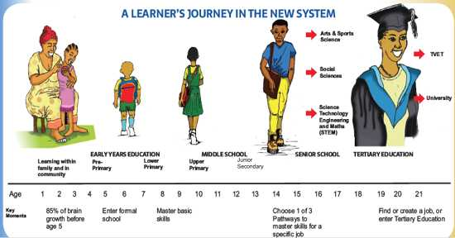
System Solution
The proposed system is a CBC Performance Grading System.
It specifically focuses on the middle school years

Slide 6
Methodology
Various methodologies are used in different phases of the project.
Data collection :- Interviews, Questionnaires
Programming :- Python
Model building :- Fuzzy logic
GUI interface :- Tkinter

Slide 7
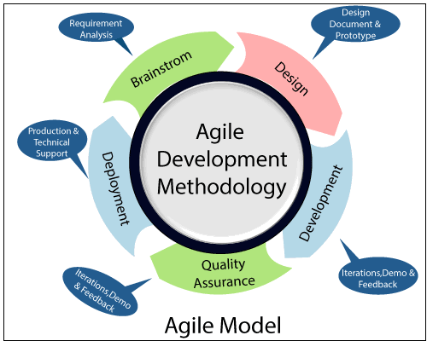
Development Methodology
Task ID | Task | Weight | Completed
1 | Requirements Engineering | 10% | Yes
2 | Fuzzy system development | 60% | Yes
3 | Interface design and implementation | 20% | Yes
4 | Quality Assurance | 8% | Partially
5 | User acceptance | 2% | Yes

Slide 8
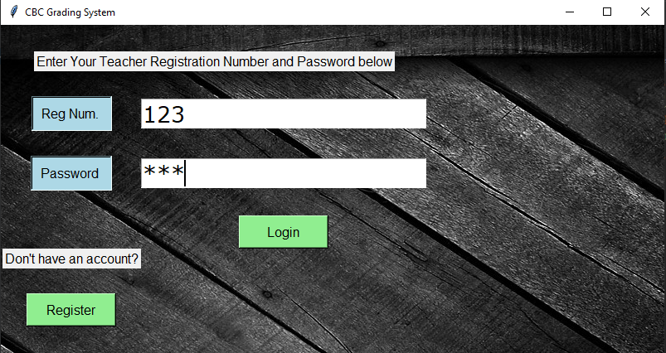
Results
This systems is designed to aid teachers in grading students
The system requires a user (teacher and heads of institution) to register themselves and login
Notes:
Cifar-10 labels: airplanes, cars, birds, cats, deer, dogs, frogs, horses, ships, and trucks

Slide 9
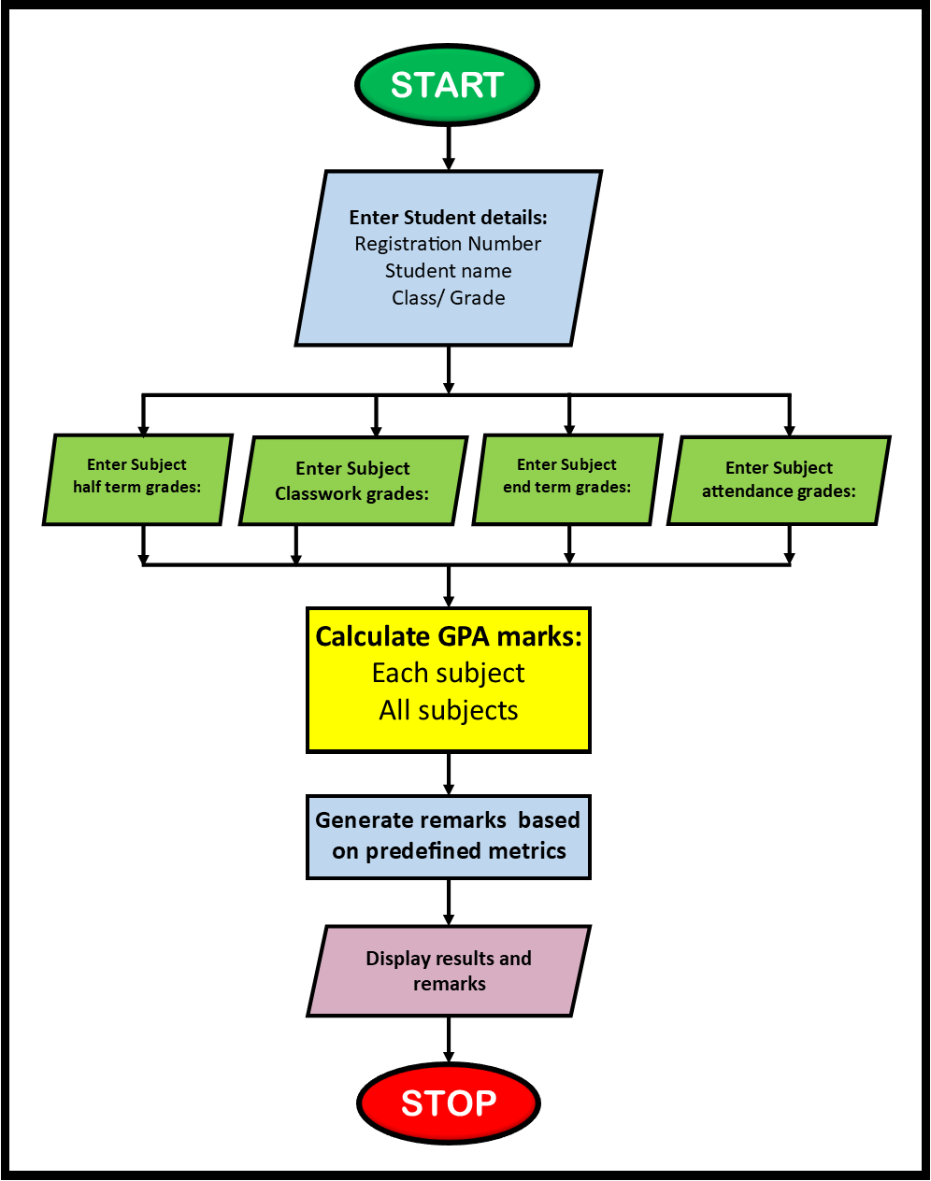
Results
The system requires grades input from the teacher
It is then runs through our trained model and a GPA grade is determined
Moreover, the system offers various comments on the specific subjects
Notes:
Cifar-10 labels: airplanes, cars, birds, cats, deer, dogs, frogs, horses, ships, and trucks

Slide 10
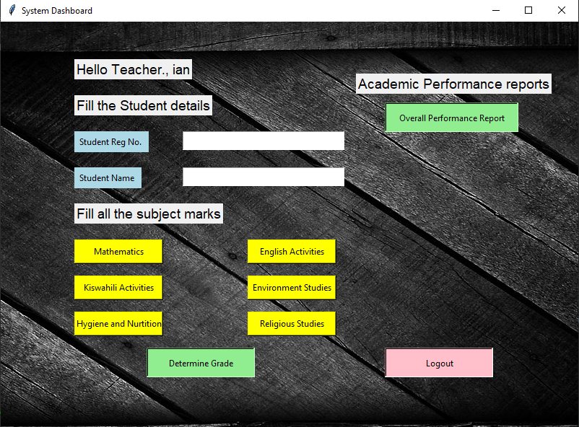
Dashboard: User Interface
Notes:
The system runs on ngrok server and is designed using Streamlit.

Slide 11
Sample Results

